Slide 1
Introduction to data warehousing
MTN.BI.07
Data Warehouse Architecture
Elias Nema
Lead Software Engineer
Elias_Nema@epam.com

Slide 2
Agenda
Data Warehouse Architectures
Accessing Data Warehouses
OLAP, MOLAP, and HOLAP
Additional Issues
The Interim Results

Slide 3
Data Warehouse Architectures: Main areas

Slide 4
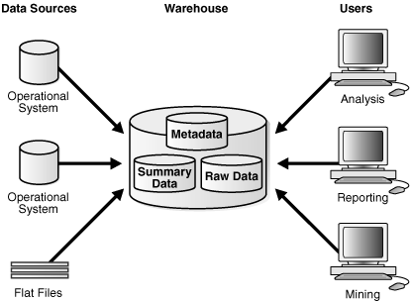
Basic Architecture

Slide 5
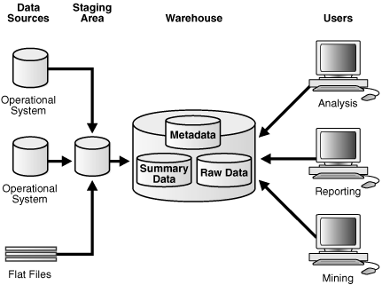
Architecture with Staging Area

Slide 6
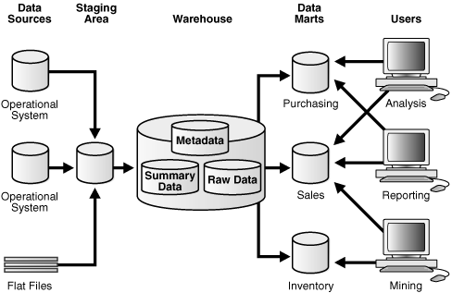
Architecture with Staging Area and Data Marts

Slide 7
Data Warehouse Architectures: points of view

Slide 8
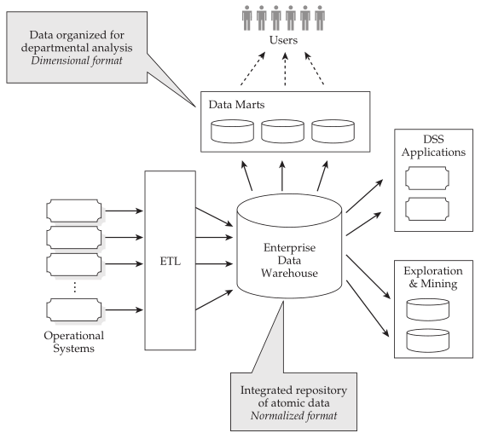
Inmon's…

Slide 9
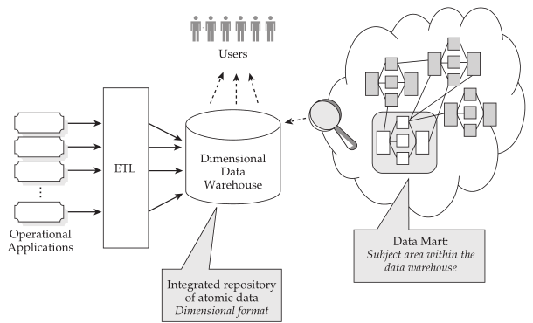
Kimball's

Slide 10
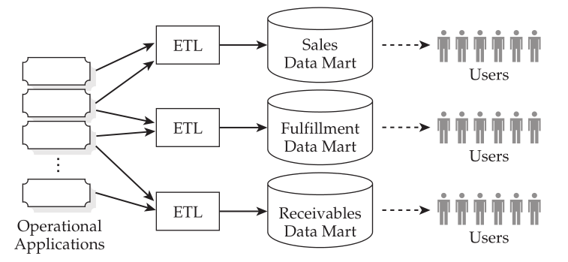
Data Marts

Slide 11
Accessing Data Warehouses

Slide 12
Accessing DWH
Analysis is the last level common to all data warehouse architecture types.
After cleansing, integrating, and transforming data, you should determine how to get the best out of it in terms of information.
There are some common best approaches for end users to query data warehouses: reports, OLAP, and dashboards. End users often use the information stored to a data warehouse as a starting point for additional business intelligence applications, such as what-if analyses and data mining.

Slide 13
Accessing DWH
Reports. Oriented to those users who need to have regular access to the information in an almost static way (some standard monthly reports summing up information on any metrics).
OLAP. OLAP might be the main way to exploit information in a data warehouse. Surely it is the most popular one, and it gives end users, whose analysis needs are not easy to define beforehand, the opportunity to analyze and explore data interactively.
Dashboards. The term dashboard refers to a GUI that displays a limited amount of relevant data in a brief and easy-to-read format. The term is a visual metaphor: the group of indicators in the GUI are displayed like a car dashboard.

Slide 14
OLAP, MOLAP, and HOLAP

Slide 15
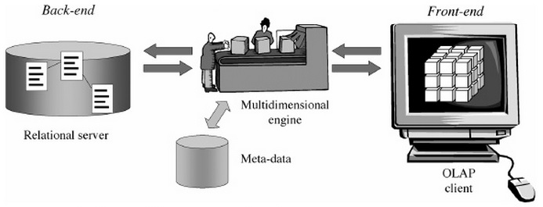
Logical Models of Data Representation
ROLAP stands for Relational OLAP, an implementation based on relational DBMSs.
MOLAP stands for Multidimensional OLAP, an implementation based on multidimensional DBMSs.
HOLAP stands for Hybrid OLAP, an implementation using both relational and multidimensional techniques.

Slide 16
Additional issues

Slide 17
Data Quality
Data quality issues should be resolved at the root, which are the transactional and reference data systems.
If this data is not clean in the source systems, cleaning it up before loading it into the data warehouse would cause a disconnected state between the information in the source systems and the data in the data warehouse.

Slide 18
Security
The applications must prevent unauthorized users from accessing or modifying data; the applications and underlying data must not be susceptible to data theft by hackers; the data must be available to the right users at the right time; and the system must keep a record of activities performed by its users.
These requirements are even more important in a data warehouse because a warehouse contains data consolidated from multiple sources. From the perspective of an individual trying to steal information, a data warehouse can be one of the most lucrative targets in an enterprise.

Slide 19
Evolution
The unstoppable evolution of application domains highlights dynamic features of data warehouses connected to the way information changes at two different levels as time goes by:
Data level. Hierarchy levels, categories and data can be changed very quickly.
Schema level. New users’ requirements, or changes in data sources, new attributes and measures can become necessary. You should also consider that the set of fact dimensions can vary as time goes by.

Slide 20
The interim results

Slide 21
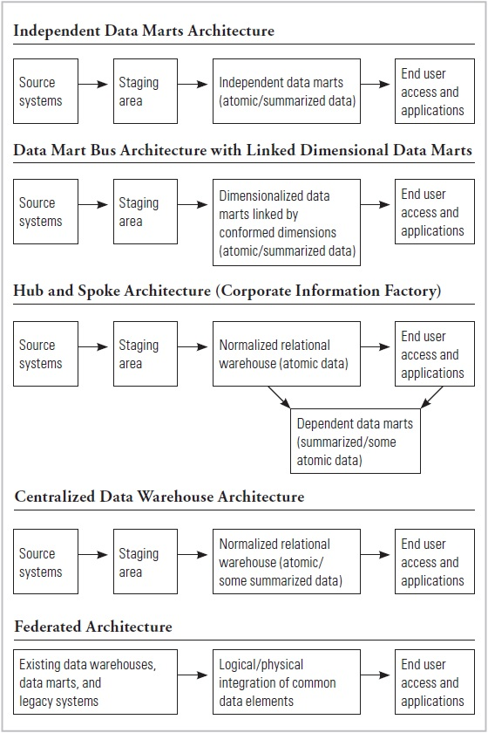
Respondents DWH Types

Slide 22
So far, so good?

Slide 23
Data Warehouse Architecture
Elias Nema
Lead Software Engineer
Elias_Nema@epam.com

